Slide 1

HOSTEL MANAGEMENT SYSTEM
GROUP 9-​
Prem V( Tc031)​
Rupak G ( Tc035)​
Siddhant D(Tc048)​
Sumit J (Tc049)​
​
Project Guided By-
Dr. Deptii C
Dr. Sandeep P

Slide 2
INTRODUCTION
Hostel Management System is a Software development for managing various activities of the hostel. The Software help user in case of Hostel Information, registration, room and Searching Hostel Account.
Aim of the Hostel Management System is to manage the records and make user friendly Software.
It helps admin to manage student records, Staff Records and many more.
Hostel management System is online application developed for managing various activities of the hostel. Deals with the problem on managing the hostel and avoided the problem which occur when carried out manually.

Slide 3
SCOPE
The proposed system provides the following features on different tasks-
All the details related to a hosteller could be find in one place like the admission details, fees details, room details , attendance ,mess details, stipend details etc.
Will make the monitoring of student moment and stock details easy.
The same application could be used by both the account section and the hostel management for their specific needs and purposes.
In future we can implement some features for “HOSTEL MANAGEMENT SYSTEM” project. In this system it's possible to categorize room rent for middle class students and poor students. Some poor students are given a particular concession for the entire year. Even we can add a gate keeping feature of in ad out which keeps the record of students going outside of hostel campus and when he/she comes.

Slide 4









REQUIREMENTS ANALYSIS
Software And Hardware Requirements-
PHP Triad (PHP, MySQL, Apache, and PHPMyAdmin)
Wamp server
HTML
Bootstrap
Sublime text
Github
JavaScript
Css
OS (windows, linux)
Notepad++
Visual Studio Code
Web Browser (Mozilla, Google Chrome)

Slide 5
PROJECT FEATURES
This project is a direct platform for students for all their hostel needs. Managing rooms , updating their profiles, applying for leaves , checking their dues and fines and submitting their grievances and problems.
This project also allows the admins to have a comfortable control over the students , check for availability of rooms , create vacancies, manage dues and fines , solving grievances and approve students of leave.
The dues/fines , permissions and grievances features are a valuable addition to the existing normal hostel management systems as it provides a seamless way of communication between the hostilities and the admin.

Slide 6
DATABASE DESIGN
Database Design:
1 | adminlogin | id username adminpassword
2 | login | id FirstName LastName MobileNumber email password
3 | studentregistration | Id Student Name Parents Name Student Surname Email Id Parents Contact Student Contact Gender Birthday Address City Pin Code State Country Room Sharing Mess Fees Paid Emergency Contact

Slide 7
4 | Courseinfo | Id Course
5 | fine | Id FirstName LastName Room Fine Status
6 | grievances | Id FirstName Emailid Room Problem Status Flag
7 | manageroom | Id Room Sharing Floor
8 | Permissions | Id FirstName Emailid Room Date of Leave Date of return Pname Relation Contact Number Reason Status Flag

Slide 8
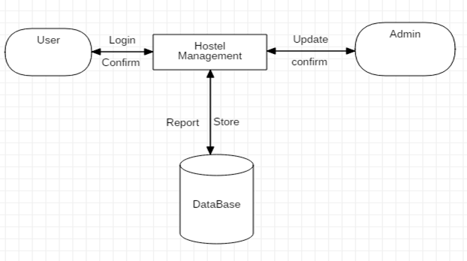
DATA FLOW DIAGRAM

Slide 9
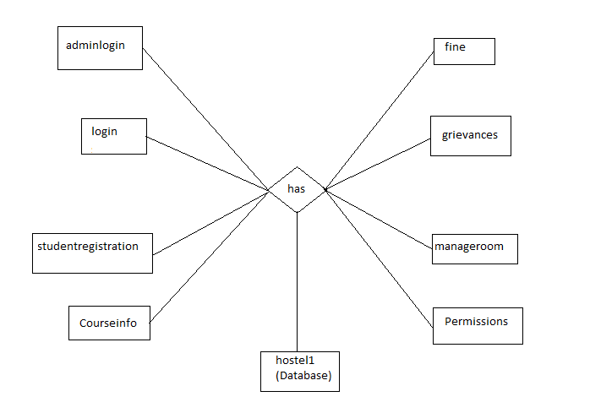
E-R DIAGRAM

Slide 10
CONCLUSION
The project, developed using PHP and MySQL is based on the requirement specification of the user and the analysis of the existing system, with flexibility for future enhancement. The expanded functionality of today’s software requires an appropriate approach towards software development.
This hostel management software is designed for people who want to manage various activities in the hostel. For the past few years the number of educational institutions are increasing rapidly.
Thereby the number of hostels are also increasing for the accommodation of the students studying in this institution. And hence there is a lot of strain on the person who are running the hostel and software’s are not usually used in this context.
This project deals with the problems on managing a hostel and avoids the problems which occur when carried manually. Identification of the drawbacks of the existing system leads to the designing of computerized system that will be compatible to the existing system with the system which is more user friendly

